Slide 1
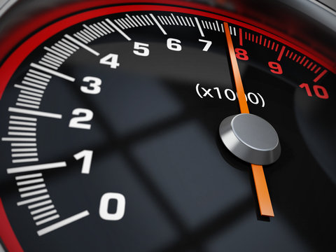

Team 26: DC Motor Rotation Control Bi-Weekly Update 2
Zachary Bauman, Terrance Smith, Rodene Corpuz-Roxas, Josiah Thompson
Sponsor: Aniruddha Datta
TA: Manoj Kumar Balamurugan

Slide 2
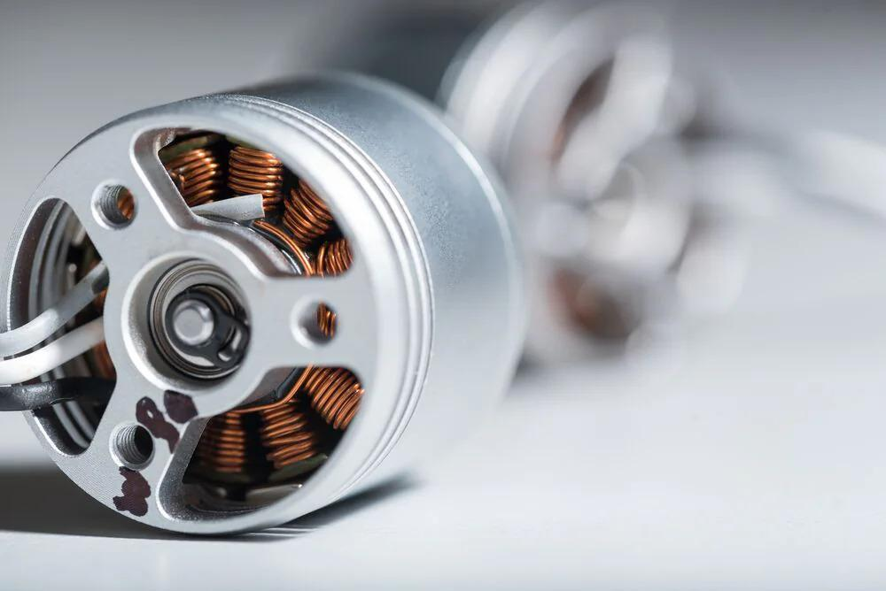
Project Summary
Problem statement:
Motors are everywhere, even in hazardous areas. And all motors need to be controlled even when an operator is not physically present.
Our Solution:
Create a custom DC motor controller that is safe and intuitive for the user.

Slide 3
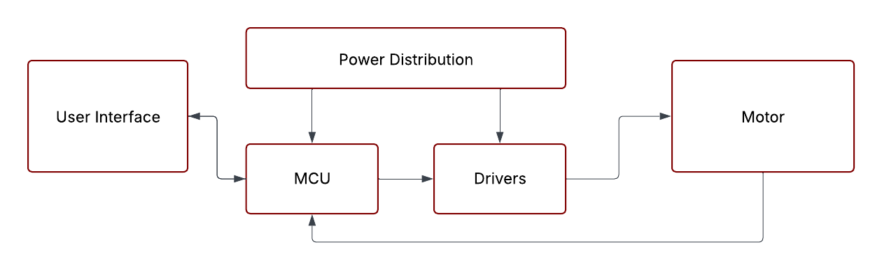
System Overview
Rodene Corpuz-Roxas
Bluetooth
Zachary Bauman
Terrance Smith
Josiah Thompson
Notes:
Cloud server and database

Slide 4
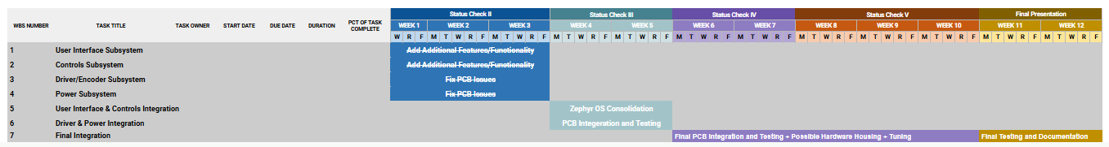
Project Timeline
Notes:
Cloud server and database

Slide 5
User Interface Subsystem
Zachary Bauman
Accomplishments since last update 24 hrs of effort | Ongoing progress/problems and plans until the next presentation
UI/UX additions to the controls and analytics In preparation of the UI & Controls Integration: BLE Operations Queue BLE/app support for CW/CCW movement Connectivity (BLE) Watchdog | Integration of UI/BLE & Control Algorithm RTOS by the next review. (Complete integration of the UI & Control Algorithm subsystems)

Slide 6
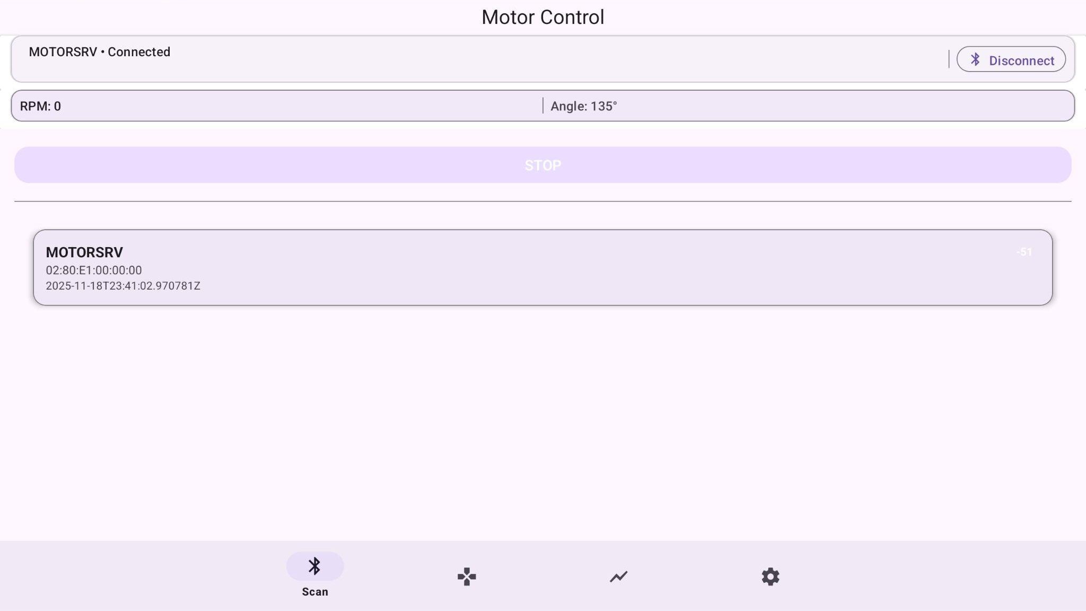
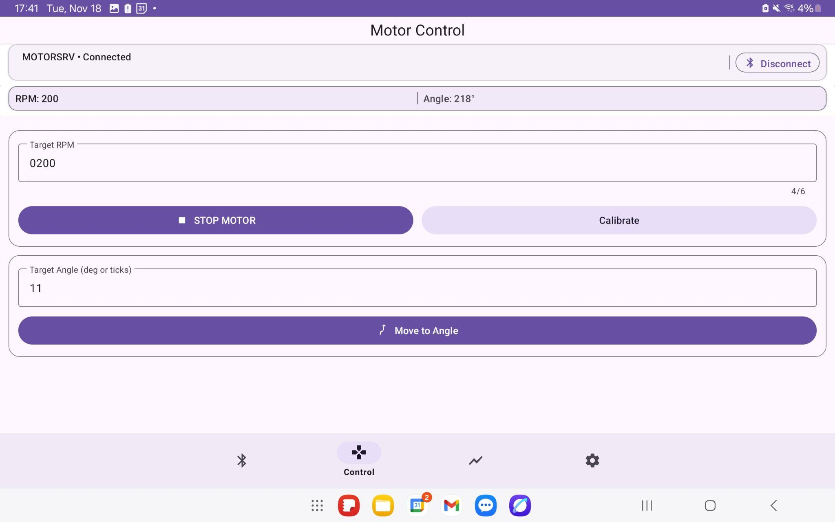
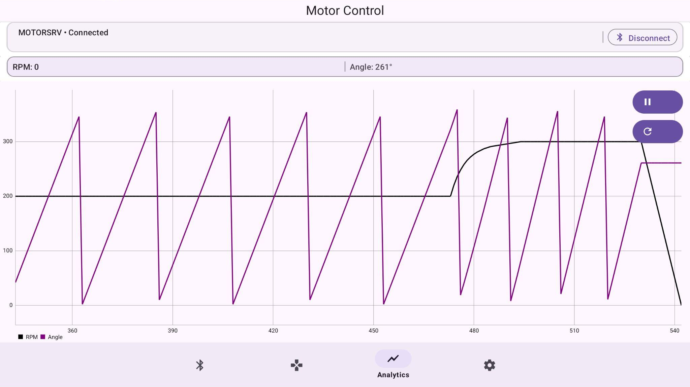
User Interface Subsystem
Zachary Bauman

Slide 7
Control Algorithm
Josiah Thompson
Accomplishments since 403 10 hrs of effort | Ongoing progress/problems and plans until the next presentation
403 Review Added coverage for edge cases Added bidirectional control functionality Added P&ID Control functionality | Implement position control Design MCU PCB from open-source schematic

Slide 8
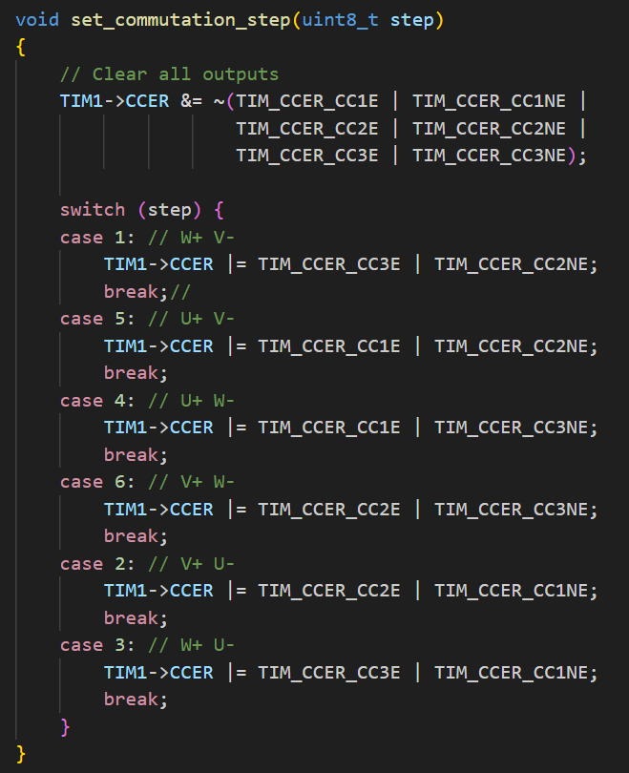
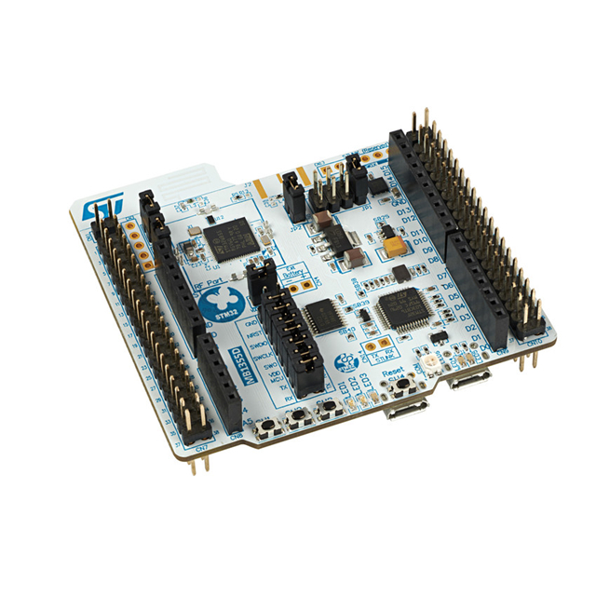
Control Algorithm
Josiah Thompson

Slide 9
Custom driver/controller
Terrance Smith
Accomplishments since last update 16 hours | Ongoing progress/problems and plans until the next presentation
fixed and ordered pcb Ordered any remaining parts needed for updated pcb Have concepts of integration with power pcb | waiting on components to begin soldering complete integration with other subsystems

Slide 10
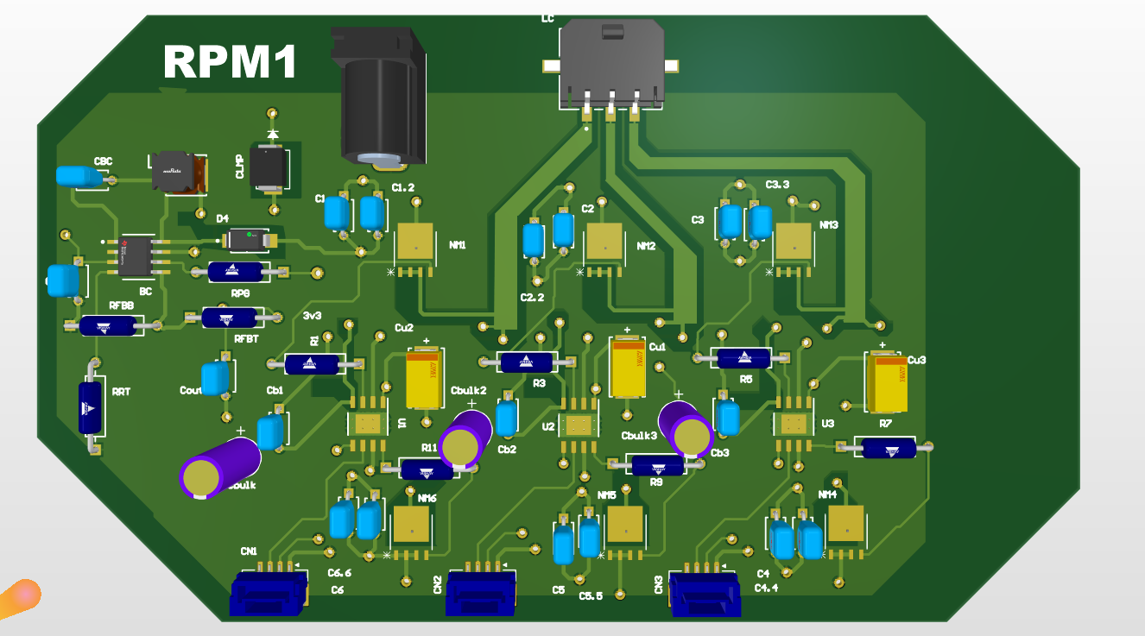
Custom Controller/Driver
Terrance Smith
Cleaned up design
removed current sensors
added inductor for BC
corrected traces

Slide 11
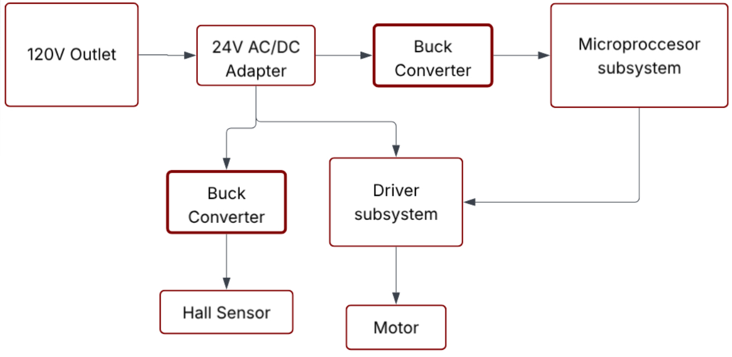
Power Rodene
PCB is tasked with converting wall input into output power supply for control system

Slide 12
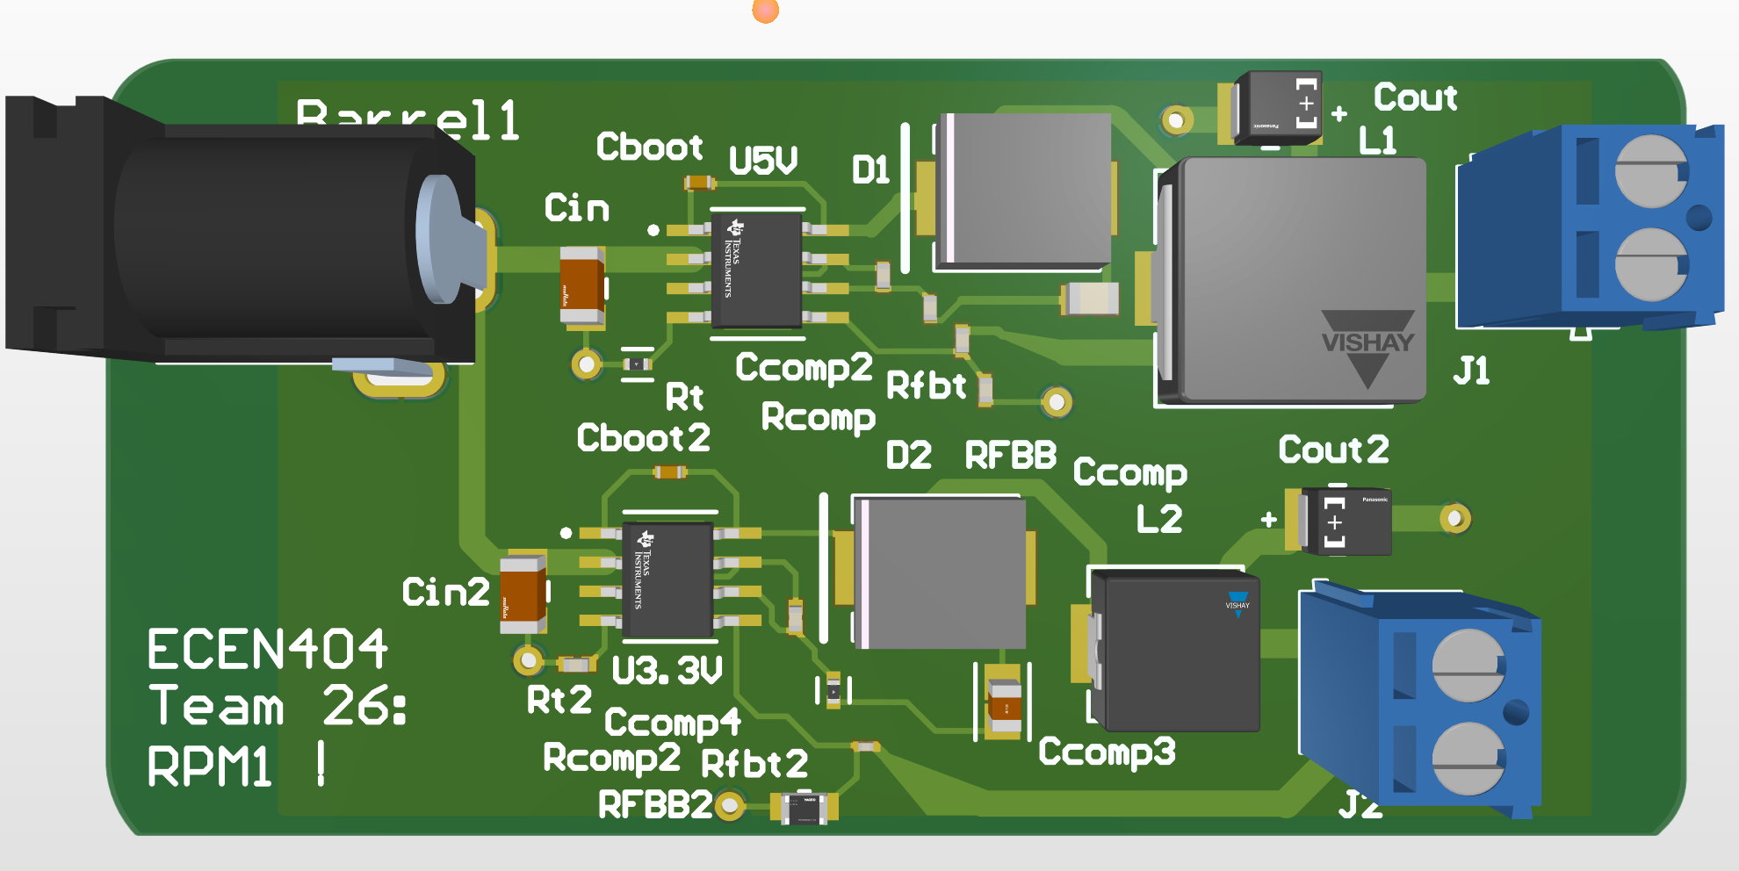
Power Rodene

Slide 13
Power Rodene Corpuz-Roxas
Accomplishments since 403 10 hours | Ongoing progress/problems and plans until the next presentation
Determined original PCB design failure was due to poorly designed ground layer. Completely overhauled the double buck converter design. Ordered/received PCB from JLC; parts ordered/received. | An inductor component needed is discontinued (DigiKey mislabeled the item listing). Complete assembly of the new power PCB as components arrive. Test the PCB with and without load before first integration with other subsystems Learning Solidworks software for full system enclosure.

Slide 14
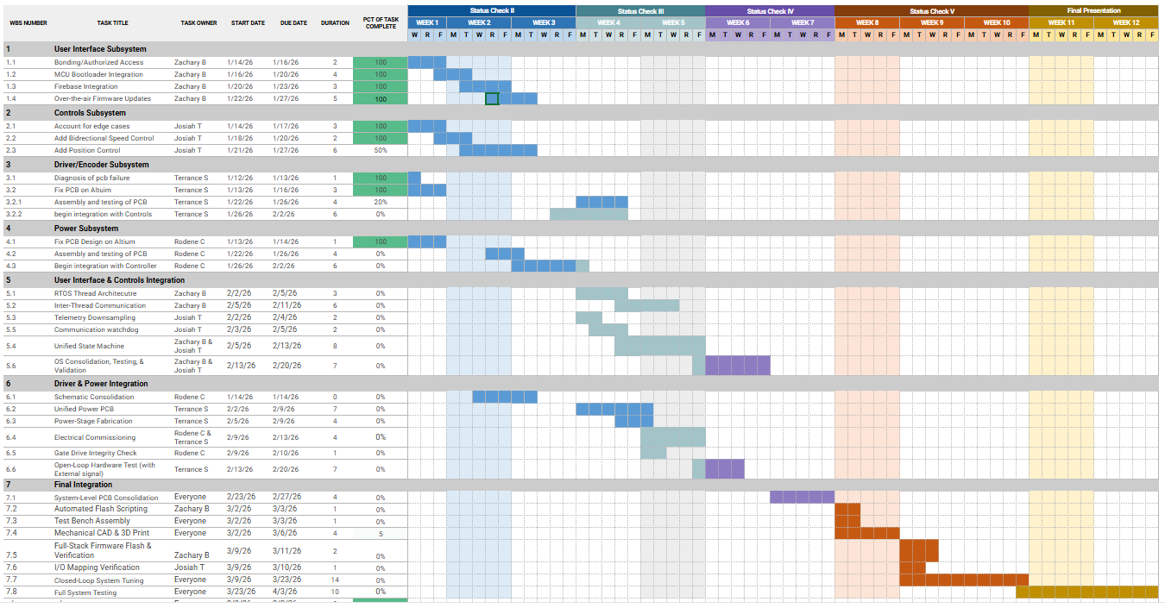
Execution Plan
Notes:
Michelle

Slide 15
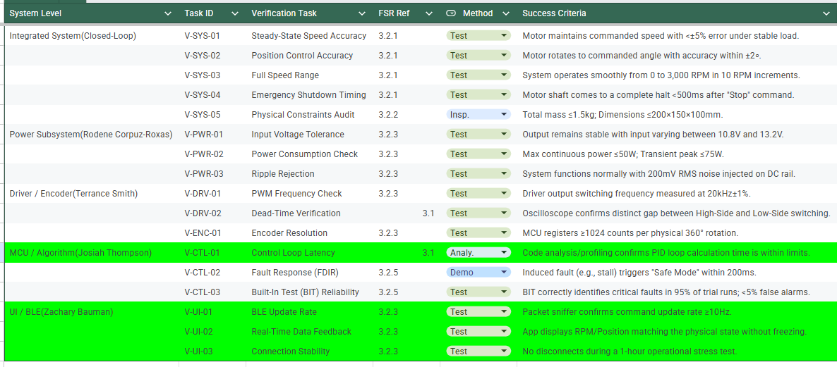
Validation Plan
Notes:
Michelle

Slide 16
Team 26: RPM1
Thanks & Gig’em
‹#›

